Slide 1
RPC-ATS

Slide 2
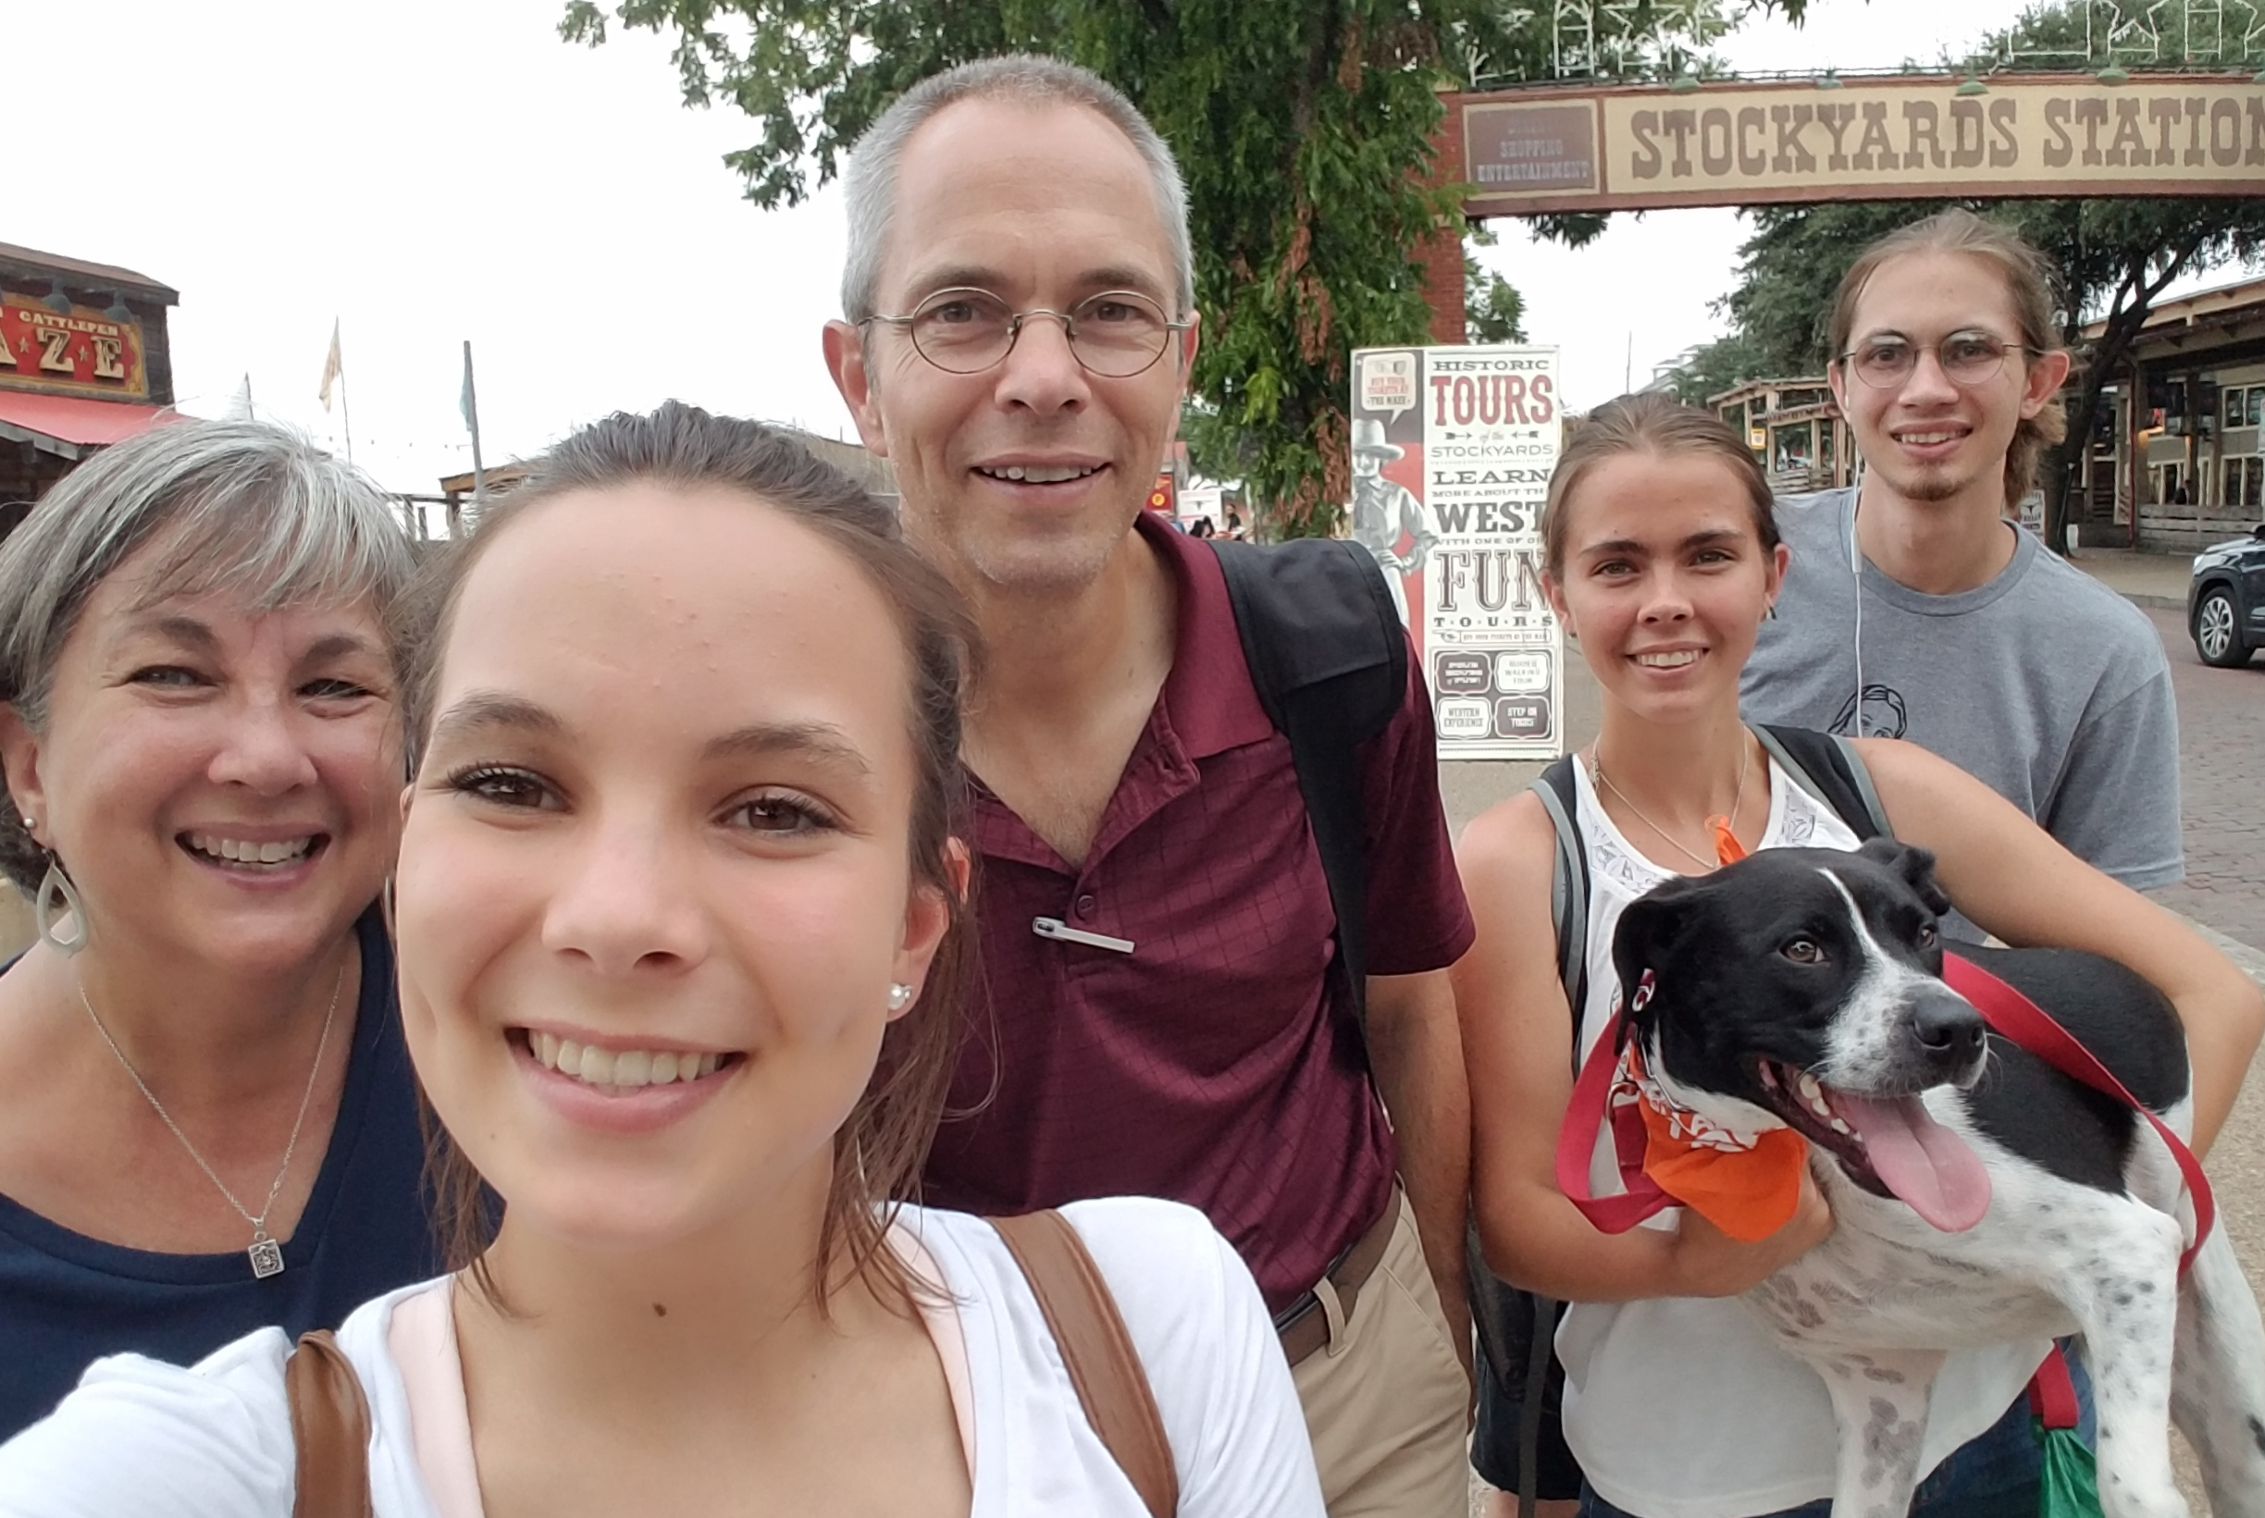
Bio - Family
One wife – Donna
Three kids – Nehemiah, Micah Joy & Miriam

Slide 3
Bio – Conversion/Call to Missions
Became a believer when I was 10 during a revival at First Baptist Church. Belen, New Mexico
During college I was deeply moved by a presentation on missions at the University of New Mexico’s Baptist Student Union. Albuquerque, New Mexico

Slide 4
Bio – Ordination/Education
Ordained Minister by New Covenant Church. Albuquerque, New Mexico 2005
Doctor of Philosophy in Theology from the South African Theological Seminary. Bryanston, Sandton, South Africa 2013-2019
Masters of Theology in Parachurch Ministries from Dallas Theological Seminary. Dallas, Texas 2001-2006
Bachelor of Science in Electrical Engineering from the University of New Mexico. Albuquerque, New Mexico 1984-1992

Slide 5
Bio – Africa Experience
Development, teaching, research and writing for Africa Theological Seminary. Kitale, Kenya 2016-present
Director of Discipleship, Station Director and Broadcast Engineer for TWR (formerly Trans World Radio). Swaziland, Benin and Kenya 1999-2001 & 2006-2016.

Slide 6
% Protestants
Millions World Wide
Africa 228.30 40.8%
Asia 99.04 17.7%
Europe 90.88 16.3%
Latin America 66.84 12.0%
Northern America 61.02 10.9%
Oceania 13.17 2.4%
Johnson, TM, GA Zurlo, AW Hickman & PF Crossing 2017. Christianity 2017: Five Hundred Years of Protestant Christianity. International Bulletin of Missionary Research, 41(1):41-52.

Slide 7
In 1900 percentage of world’s Protestants that were African:
1.7%

Slide 8
“The church in Africa was a mile long in terms of quantity, but only an inch deep in terms of quality.”
Tokunboh Adeyemo

Slide 9
Missionaries % Increase
per Million Last
Christians 100 Years
Africa 42 1.5%
Asia 134 11%
Europe 226 2.4%
Latin America 106 21%
Northern America 477 2.7%
Oceania 215 2.4%
Center for the Study of Global Christianity. 2010. Christianity 2010: A view from the new atlas of global Christianity. International Bulletin of Missionary Research, 34 (January): 29-36 .

Slide 10
Why Mission Work in Africa
Theological Education is key to helping Africa mature
North Africa is still unreached
Given the task ahead, the African church needs help

Slide 11
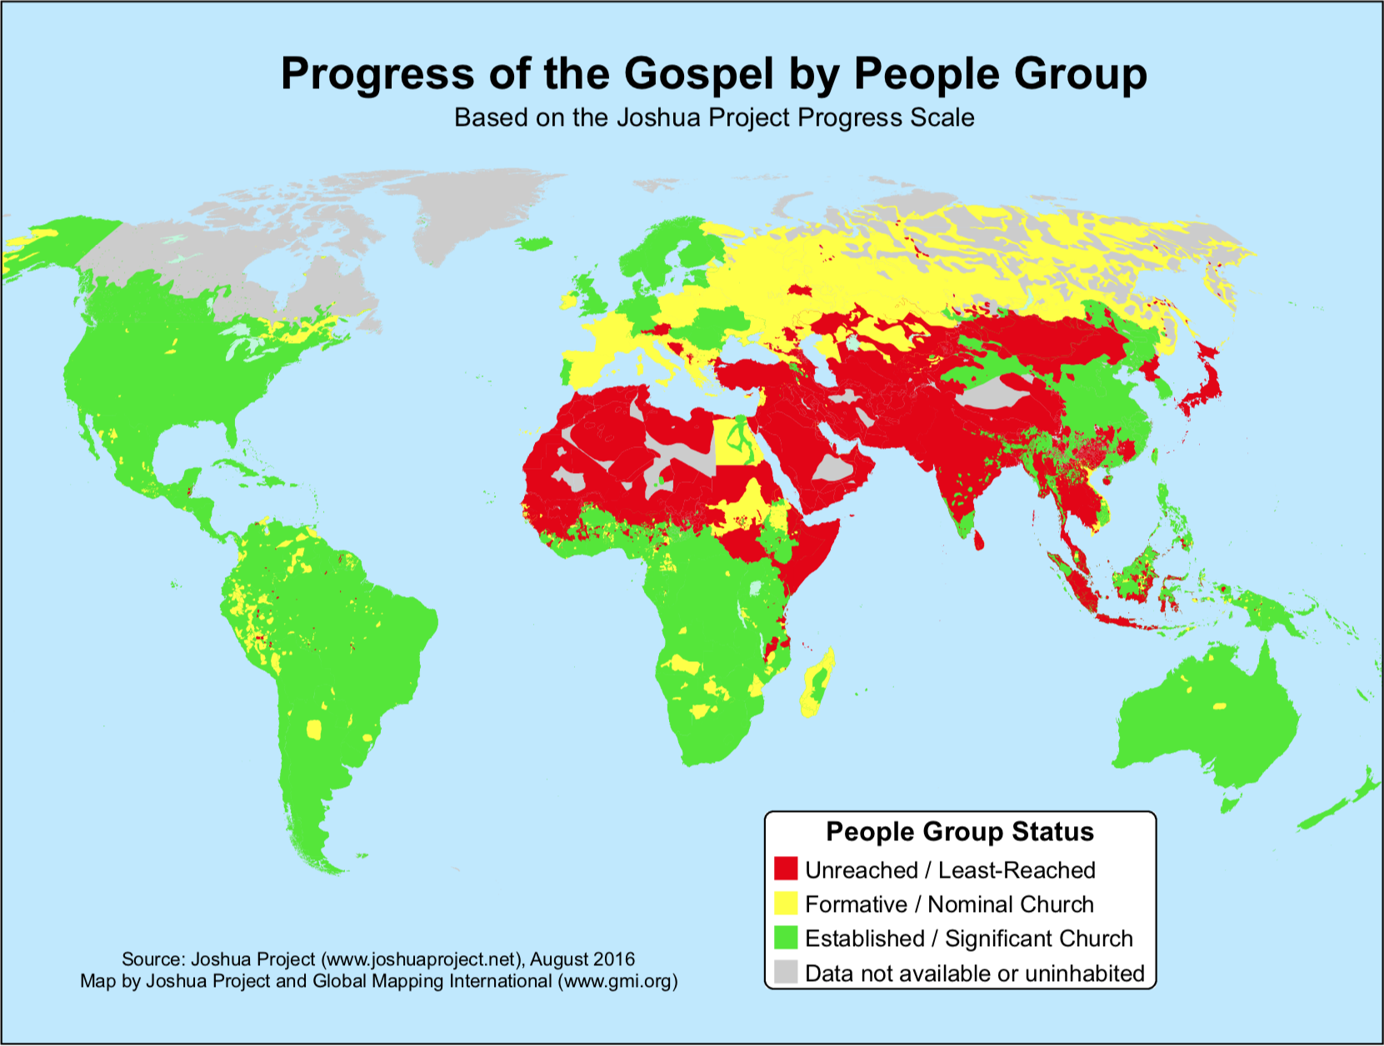

Slide 12
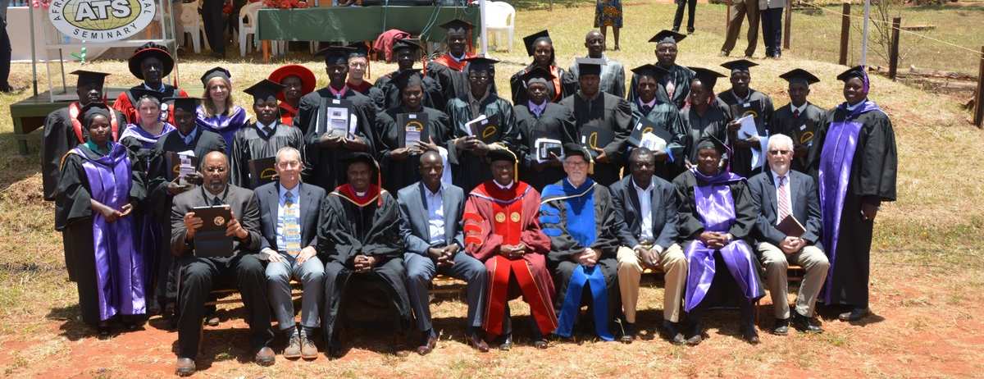
Africa Theological Seminary
VISION STATEMENT:
“Empowered Christian Leaders Transforming Africa and the World”

Slide 13
Africa Theological Seminary
MISSION STATEMENT:
“Africa Theological Seminary exist to serve the church by providing quality, relevant, in-service theological education for the discipling and equipping of its leaders.”

Slide 14
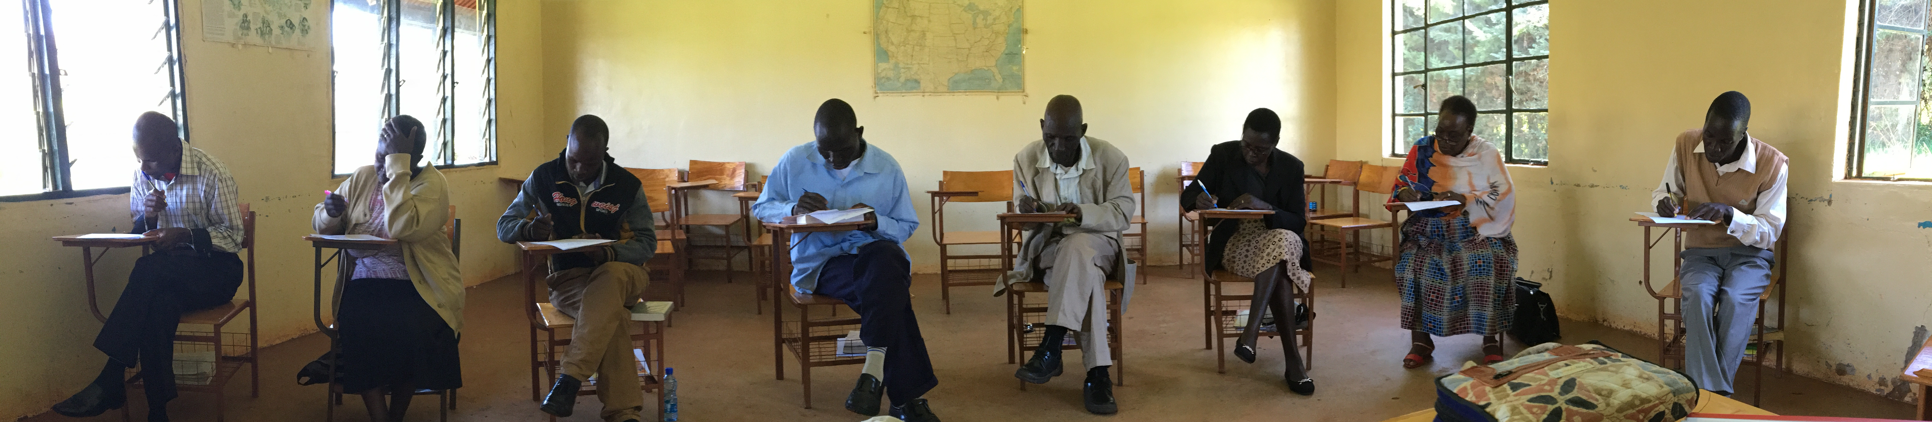
Africa Theological Seminary
MOTTO:
Training the Heart
Instructing the Mind &
Empowering the Hands

Slide 15
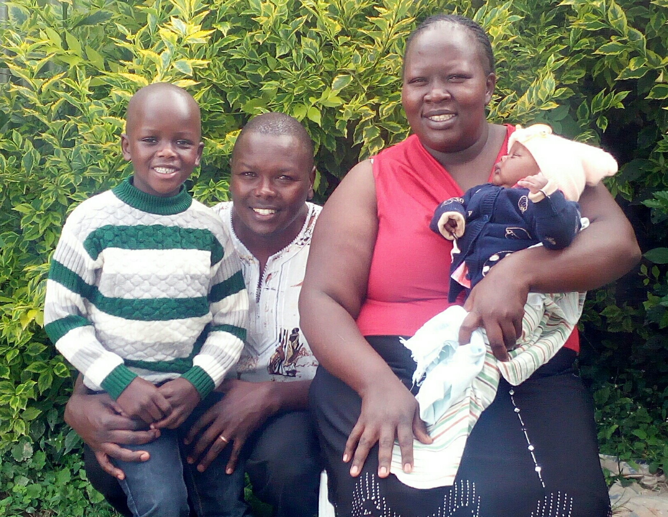
Alfred Rutto
Vice President of Academic Affairs / Teaching Faculty
Ian, Alfred, Nancy & Brian

Slide 16
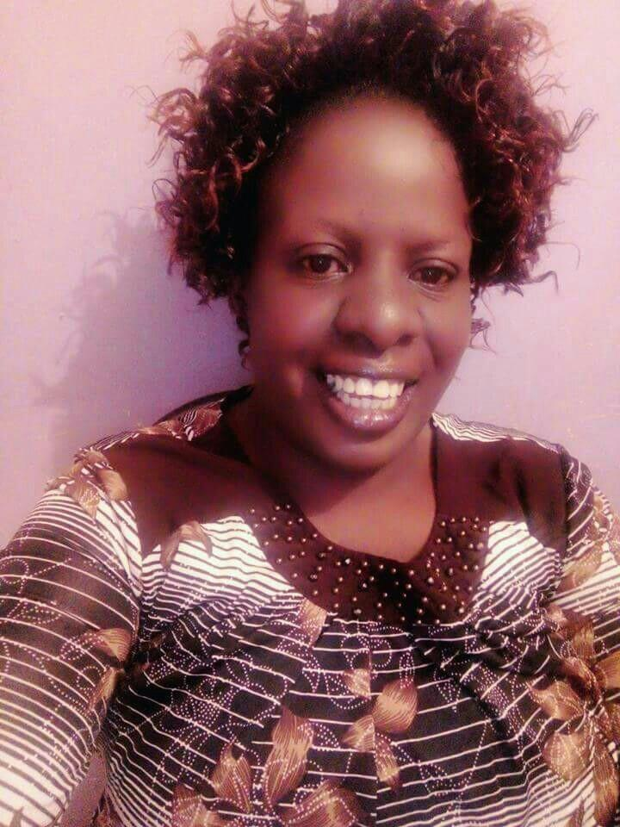
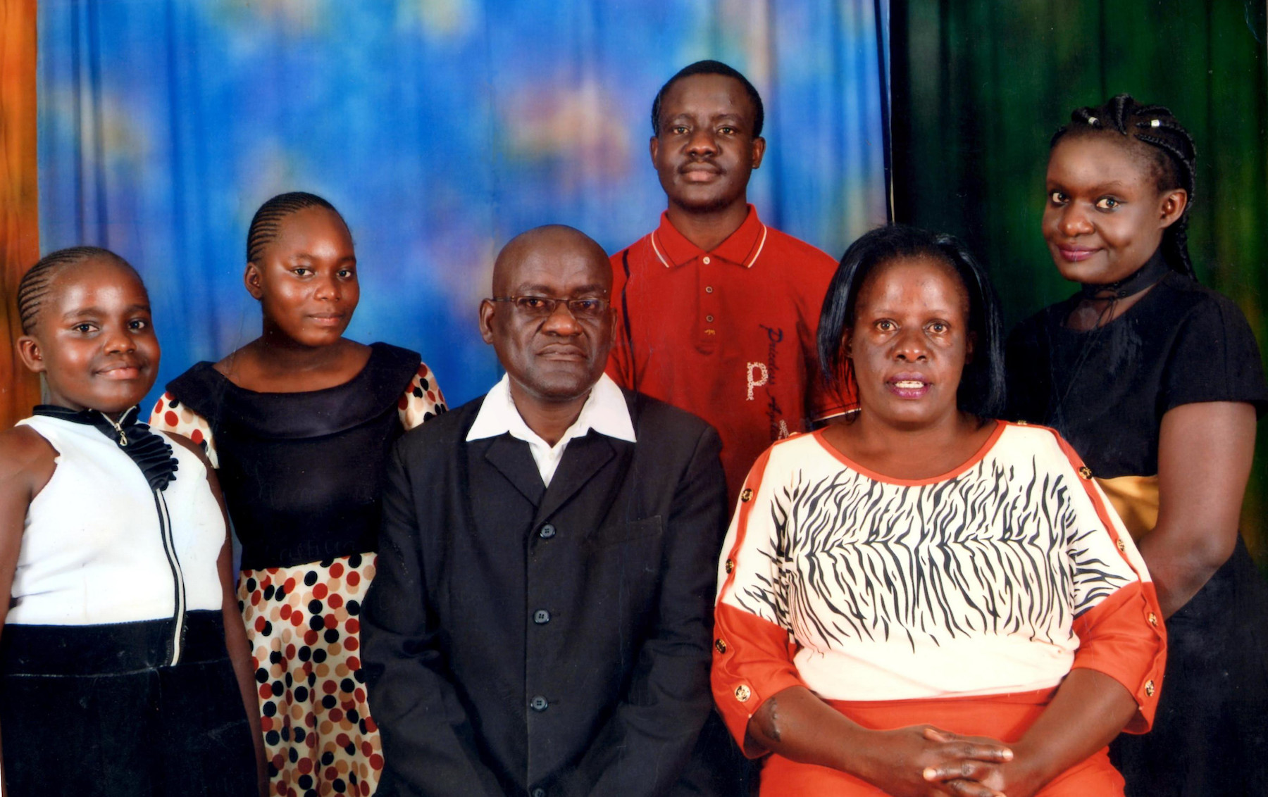
Emmy Oriaro
Head Librarian
Joy, Noreen, Paul, Solomon, Emmy & Ivy

Slide 17
My Role at ATS
Teach: Train students in Bible and Theology in Kitale, Kenya. Four months out of the year.
Grade: Evaluate fieldwork of students to encourage progress and correct. Year round.
Development: Raise awareness of the work at ATS along with encouraging prayer and financial gifts. Eight months out of the year.
Research/Write: Produce academic articles for ATS. Year round.

Slide 18
Notes:
Video

Slide 19
Get Involved
Pray
ATS icmusa.org/ats/pray (newsletter coming soon)
Alfred Rutto icmusa.org/ats/rutto
Emmy Oriaro icmusa.org/ats/oriaro
Paul & Donna cox-net.com/prayer_blog (email)
Visit
Give Financially
Sheppard Scholarships
Support ATS staff member(s)

Slide 20
RPC-ATS-End

Slide 21
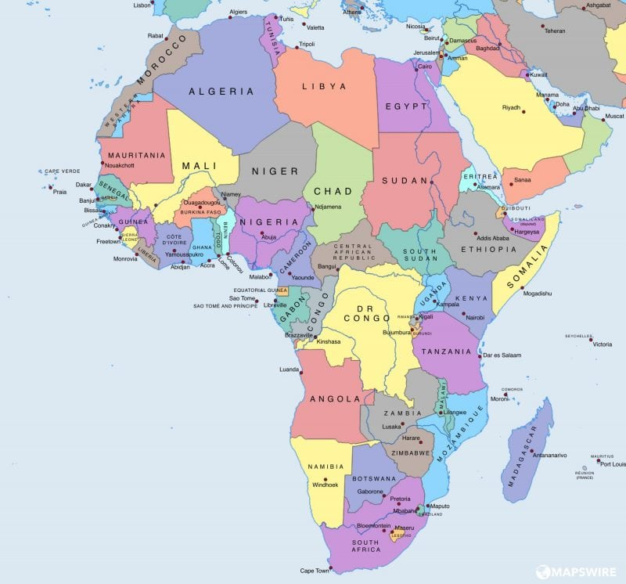

Slide 22
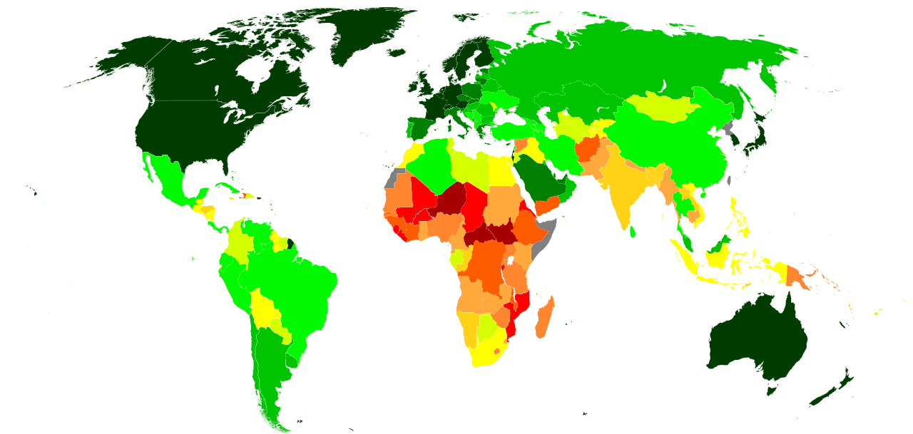
UN Human Development Index

Slide 23
